Slide 1
Compiler Design (22CS302) III B.Tech – I Semester
Department of Computer Science and Engineering

Slide 2
Specification of Tokens
To specify tokens regular expressions are used.
When a pattern is matched by some regular expression then token can be recognized.
Strings and Languages
Operations on Languages
Regular Expressions
Regular Definitions
Extensions of Regular Expressions
Department of Computer Science and Engineering

Slide 3
1. Strings and Languages
Symbol:
It is an abstract entity.
e.g: letters, digits and punctuation
Alphabet:
A finite non-empty set of symbols is called ‘alphabet’.
e.g: ∑={0,1}, ∑={a,b,c,d}
Department of Computer Science and Engineering

Slide 4
1. Strings and Languages
String:
A string over an alphabet is a finite sequence of the symbols drawn from that alphabet.
e.g: In ∑={a,b} is the alphabet
ab, abb are valid strings, where as abc is not a string because ‘c’ doesn’t belongs to ∑.
Length of a String
The number of symbols in a string w is called its length, denoted by |w|.
e.g: | 011 | = 3, |11| = 2, | b | = 1
ε is the empty string, the length of the empty string is ‘0’.
Department of Computer Science and Engineering

Slide 5
1. Strings and Languages
String Operations:
Concatenation:
→ If x and y are strings, then the concatenation of x and y, denoted xy, is the string formed by appending y to x.
For example, if x = dog and y = house, then xy = doghouse.
→ The empty string is the identity under concatenation;that is,
for any string s, ε.s=s. ε=s.
Exponentiation of strings as follows:
s⁰ ₌ ε , s^{n} ₌ s s s .. s ( n times)
Department of Computer Science and Engineering

Slide 6
1. Strings and Languages
Prefix: Any sequence of leading symbols over the given string is called ‘prefix’.
Example: For the string ‘cse’, the possible prefixes are ε, c, cs, cse.
Suffix: Any sequence of trailing symbols over the given string is called ‘suffix’.
Example: For the string ‘cse’, the possible suffixes are ε, e, se, cse.
Substring: Any sequence of symbols over the given string is called ‘substring’.
Example: For the string ‘computer’ the possible substrings are ε, com, put, te, mp,….
Language: A language over an alphabet is a set of strings over that alphabet.
e.g: ∑={a,b}
L={aa, abb, bab, bbaaa}
Department of Computer Science and Engineering

Slide 7
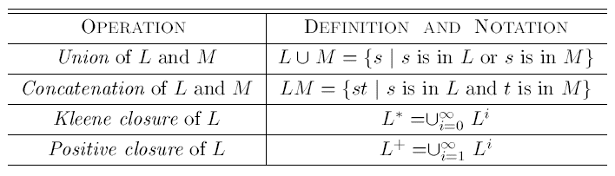
2. Operations on Languages
Definitions of operations on languages
Department of Computer Science and Engineering

Slide 8
2. Operations on Languages
Concatenation
L₁L₂ = { s₁s₂ | s₁ ∈ L₁ and s₂ ∈ L₂ }
Union
L₁ ∪ L₂ = { s | s ∈ L₁ or s ∈ L₂ }
Exponentiation
L⁰ = {ε} L¹ = L L² = LL
Kleene Closure
L* =
Positive Closure
L⁺ =
Department of Computer Science and Engineering

Slide 9
2. Operations on Languages
L₁ = {a,b,c,d} L₂ = {1,2}
L₁L₂ = {a1,a2,b1,b2,c1,c2,d1,d2}
L₁ ∪ L₂ = {a,b,c,d,1,2}
L₁³ = all strings with length three (using a,b,c,d}
L₁* = all strings using letters a,b,c,d and empty string
L₁⁺ = doesn’t include the empty string
Department of Computer Science and Engineering

Slide 10
3. Regular Expressions
By using regular expressions to describe tokens of a programming language.
A regular expression is built up of simpler regular expressions (using defining rules).
Each regular expression denotes a language.
A language that can be defined by a regular expression is called as a regular set.
Department of Computer Science and Engineering

Slide 11
3. Regular Expressions
Regular expressions over alphabet Σ
Reg. Expr Language it denotes
ε {ε}
a∈ Σ {a}
(r₁) | (r₂) L(r₁) ∪ L(r₂)
(r₁) (r₂) L(r₁) L(r₂)
(r)* (L(r))*
(r) L(r)
(r)⁺ = (r)(r)*
(r)? = (r) | ε
Department of Computer Science and Engineering

Slide 12
3. Regular Expressions (cont..)
We may remove parentheses by using precedence rules.
* highest
concatenation
| lowest
ab*|c means (a(b)*)|(c)
Ex:
Σ = {0,1}
0|1 => {0,1}
(0|1)(0|1) => {00,01,10,11}
0* => {ε ,0,00,000,0000,....}
(0|1)* => all strings with 0 and 1, including the empty string
Department of Computer Science and Engineering

Slide 13
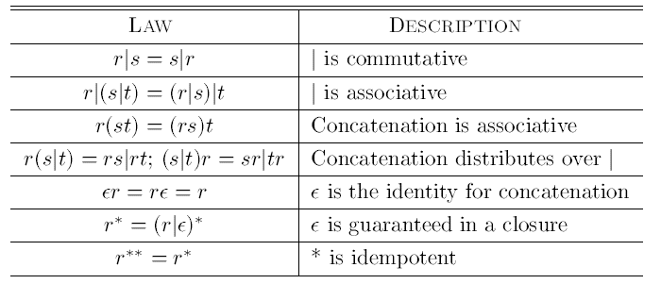
3. Regular Expressions (cont..)
Algebraic laws for regular expressions
Department of Computer Science and Engineering

Slide 14
4. Regular Definitions
To write regular expression for some languages can be difficult, because their regular expressions can be quite complex. In those cases, we may use regular definitions.
We can give names to regular expressions, and we can use these names as symbols to define other regular expressions.
Department of Computer Science and Engineering

Slide 15
4. Regular Definitions
A regular definition is a sequence of the definitions of the form:
d₁ → r₁
d₂ → r₂
...
d_{n} → r_{n}
where d_{i} is a distinct name and
r_{i} is a regular expression over symbols in
Σ∪{d₁,d₂,...,d_{i-1}}
basic symbols previously defined names
Department of Computer Science and Engineering

Slide 16
4. Regular Definitions (cont..)
Ex: Identifiers in Pascal
letter → A | B | ... | Z | a | b | ... | z
digit → 0 | 1 | ... | 9
id → letter (letter | digit ) *
If we try to write the regular expression representing identifiers without using regular definitions, that regular expression will be complex.
(A|...|Z|a|...|z) ( (A|...|Z|a|...|z) | (0|...|9) ) *
Department of Computer Science and Engineering

Slide 17
4. Regular Definitions (cont..)
Ex: Unsigned numbers in Pascal
digit → 0 | 1 | ... | 9
digits → digit digit *
opt-fraction → . digits | €
opt-exponent → ( E (+|-|€) digits ) | €
unsigned-num → digits opt-fraction opt-exponent
Department of Computer Science and Engineering

Slide 18
5. Extension of Regular Expressions
Since Kleene introduced regular expressions with the basic operators for union, concatenation, and Kleene closure in the 1950s, many extensions have been added to regular expressions to enhance their ability to specify string patterns.
Here we mention a few notational extensions that were first incorporated into Unix utilities such as Lex that are particularly useful in the specification lexical analyzers.
1. One or more instances
2. Zero or one instance
3. Character classes
Department of Computer Science and Engineering

Slide 19
5. Extension of Regular Expressions
Using these shorthands, we can rewrite the regular definition of identifier and unsigned numbers.
Ex: Identifiers in Pascal
letter → [A-Za-z]
digit → [0-9]
id → letter (letter | digit ) *
Ex: Unsigned numbers in Pascal
digit → [0-9]
digits → digit ⁺
number → digits (.digits)? (E[+-]? digits)?
Department of Computer Science and Engineering

Slide 20
THANK YOU
Department of Computer Science and Engineering

